Slide 1
SOCIAL MEDIA
AND ITS IMPACT

Slide 2

WHAT IS SOCIAL MEDIA?
“Social media is an internet-based form of communication. It allows users to share information and create web content.” — USF

Slide 3
UNDERSTANDING SOCIAL MEDIA
Social media = online communication + sharing platform
Enables instant global connection
Plays a major role in shaping behavior and lifestyle

Slide 4
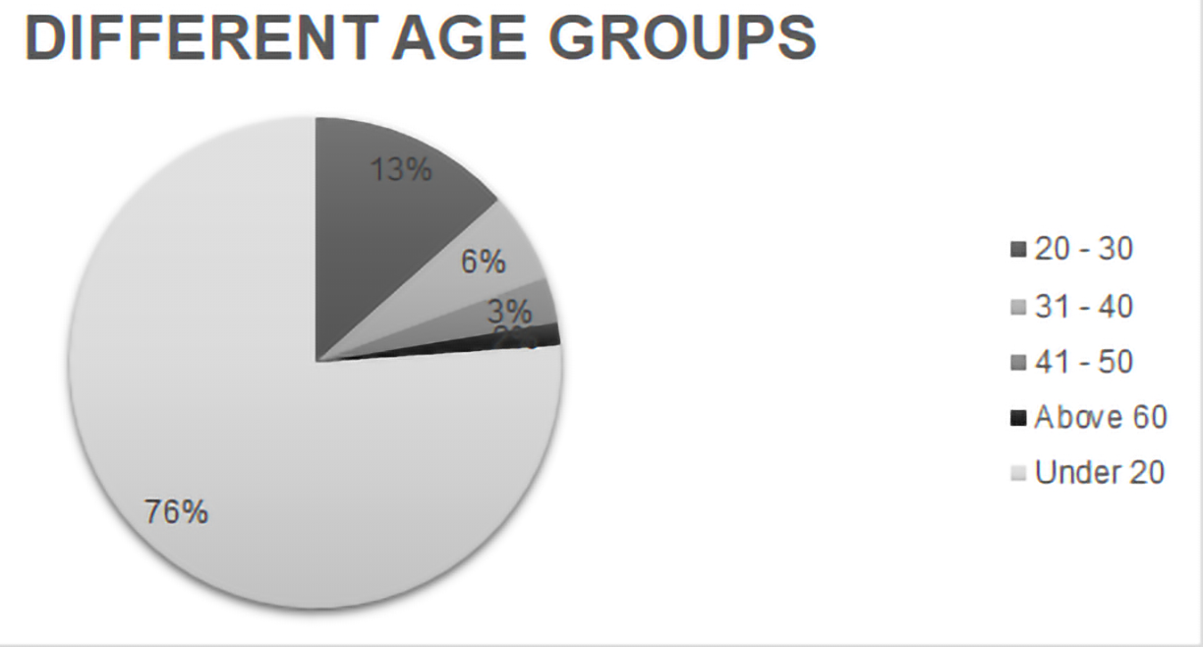
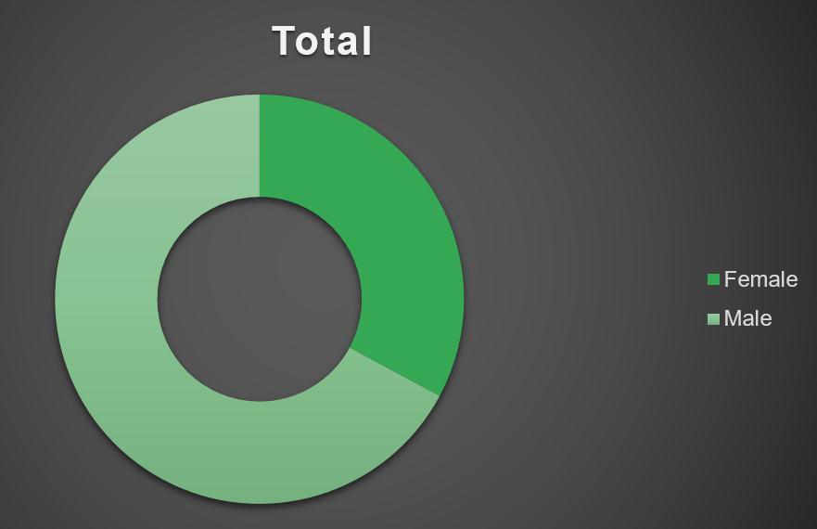
DEMOGRAPHIC PROFILE BASED ON THE SURVEY
76% of respondents are under 20 years old
Gender split: 67% Male, 33% Female
Education: 75% Intermediate level, 16% Bachelor's degree
Diverse occupations: Students, Professionals, Homemakers
Representative sample across age groups 13-50+

Slide 5
PLATFORM AND CONTENT PREFERENCES
Instagram dominates among younger users (under 20)
WhatsApp preferred for communication across ages
Entertainment content: 65% primary preference
Educational content: 20% regular consumption

Slide 6
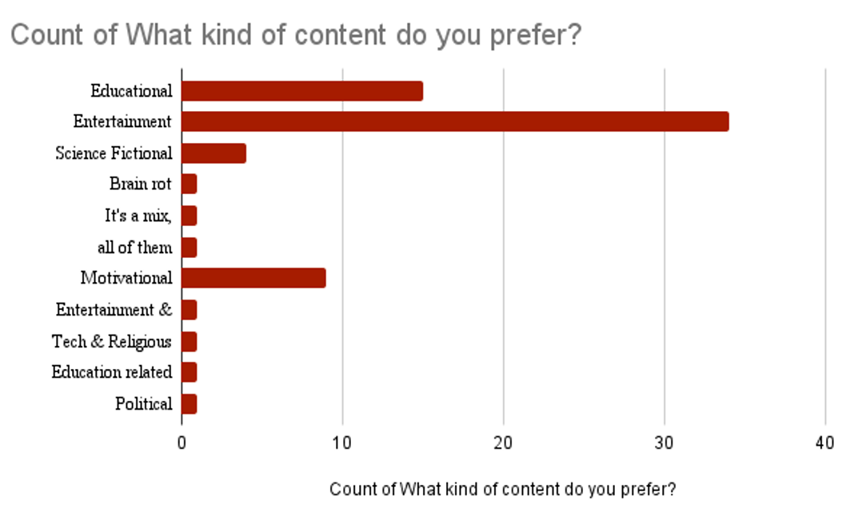
USAGE PURPOSES
Entertainment: Primary driver for 55% of users
Stay Updated: Second most common purpose (30%)
Networking: Professional & social connections (10%)
Time Killing: Passive consumption habit (5%)
Educational: Intentional learning usage patterns

Slide 7
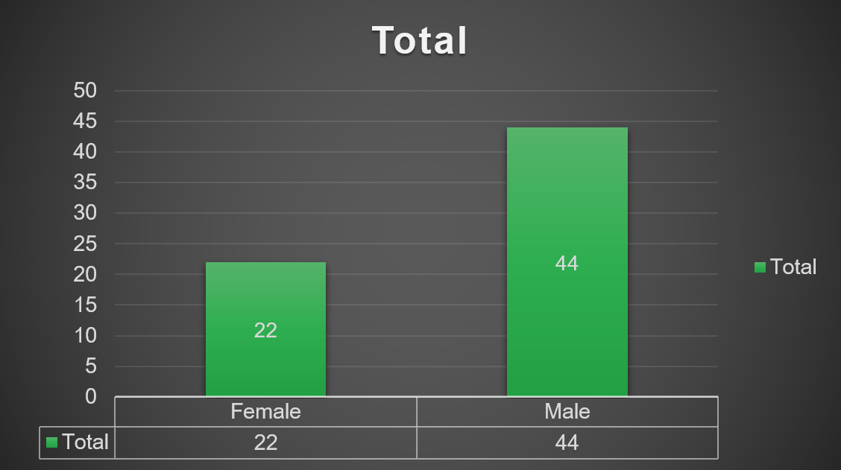
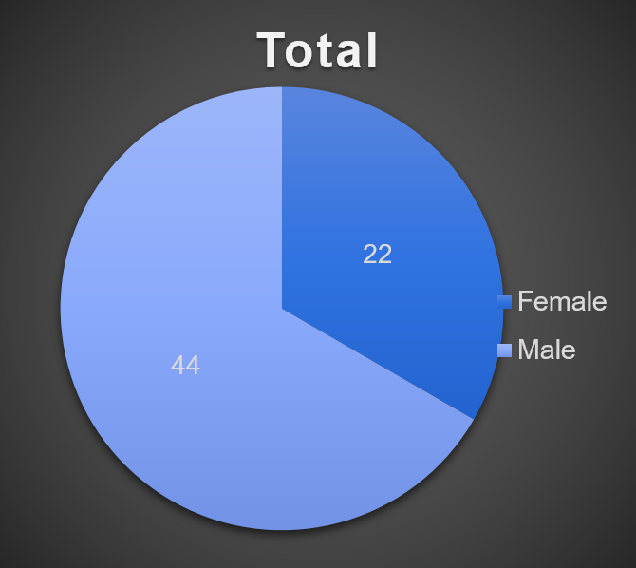
MENTAL & PHYSCIAL IMPACT
Poor sleep
Low physical activity
Depression & anxiety
Weight and concentration issues
Count of Affect on
Mental Health

Slide 8
PRIVACY & DATA CONCERNS
70% express high privacy concerns (8-10/10)
Younger users show higher awareness levels
Platform trust varies significantly
Data tracking understanding impacts usage
Age influences privacy protection behaviors

Slide 9
USER BEHAVIOUS PATTERNS
Heavy users (6+ hours): Entertainment focus, multiple platforms
Moderate users (2-3 hours): Balanced content consumption
Light users (1 hour): Intentional, purpose-driven usage
Content-purpose alignment varies by intensity
Platform choice influences usage duration

Slide 10
AGE-BASED INSIGHTS
Under 20: Highest variability, entertainment focus
20-30: More balanced, professional networking
31-40: Purpose-driven, specific content preferences
41+: Limited platforms, communication primary
Usage maturity increases with age

Slide 11
RECOMMENDATIONS & SOLUTIONS
Promote educational content for balanced usage
Implement screen time awareness programs
Address privacy concerns through transparency
Encourage diverse content consumption
Support mental health awareness in digital literacy

Slide 12
CONCLUSION
Social media impact is multi-dimensional
User behavior determines experience quality
Balanced approach yields positive outcomes
Continuous adaptation needed for healthy usage
Data-driven insights guide better practices

